Slide 1
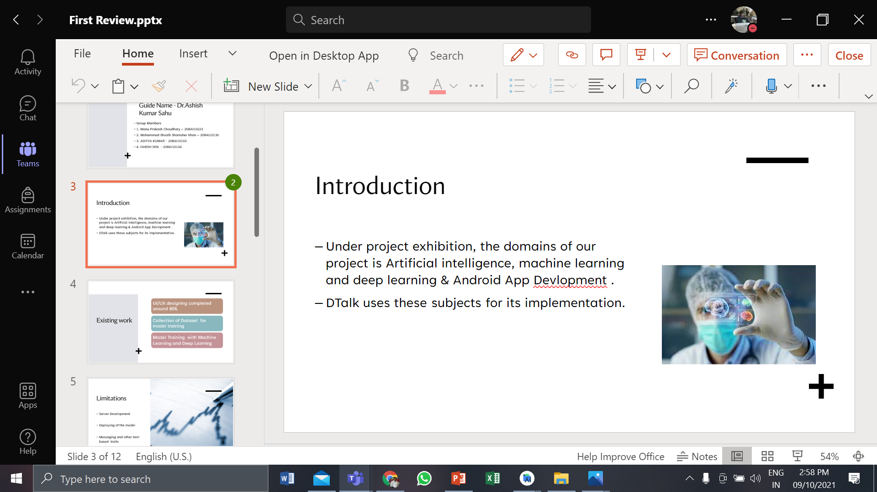
DtaLK using Machine Learning

Slide 2
Introduction DtaLK using Machine Learning
The domains of our project is machine learning. Deep Learning & Android App Development .​
DtaLK uses these subjects for its implementation.​
​

Slide 3
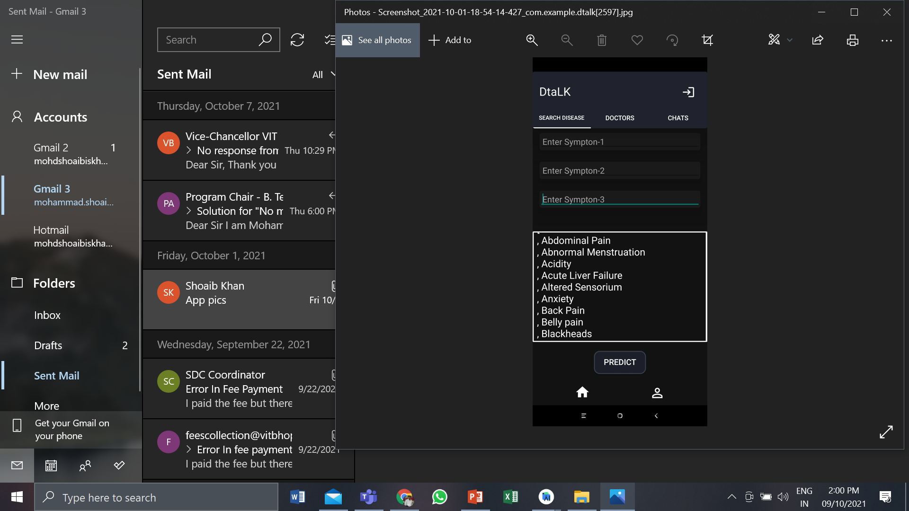

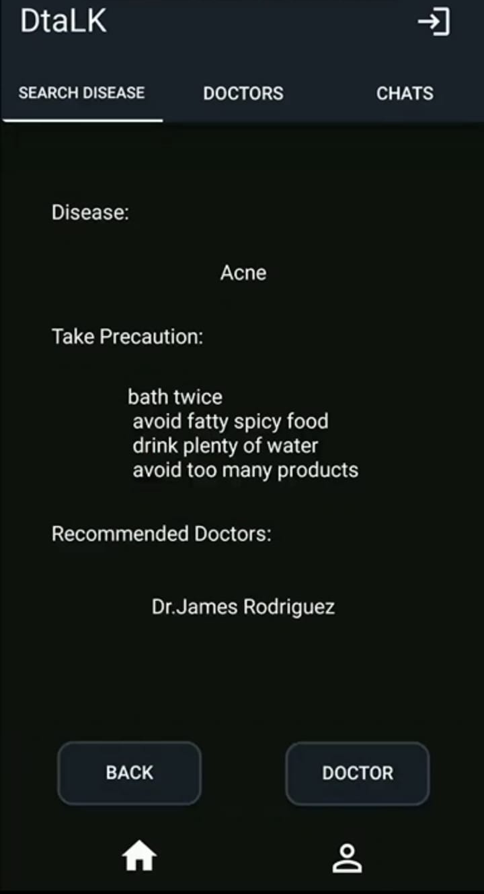
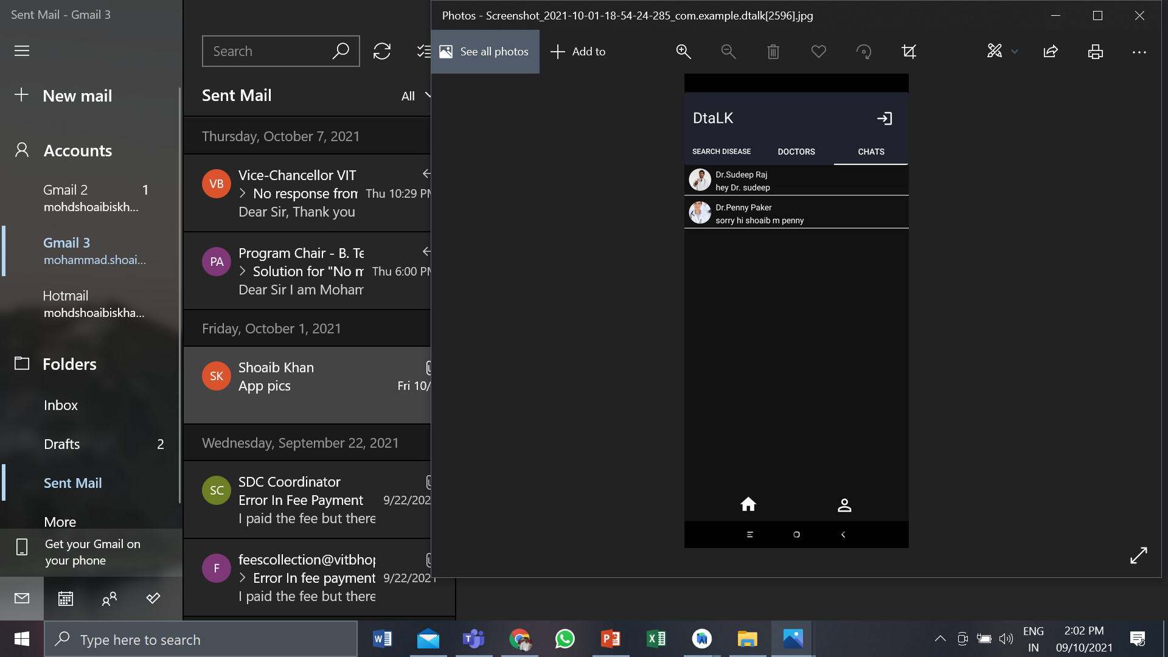
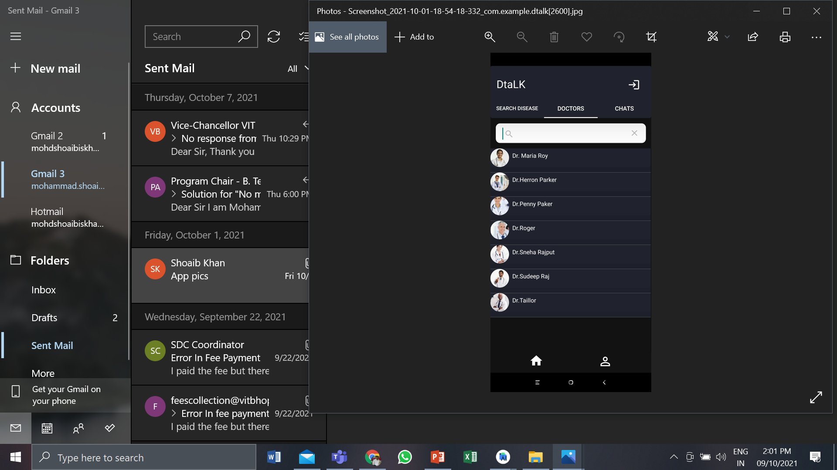
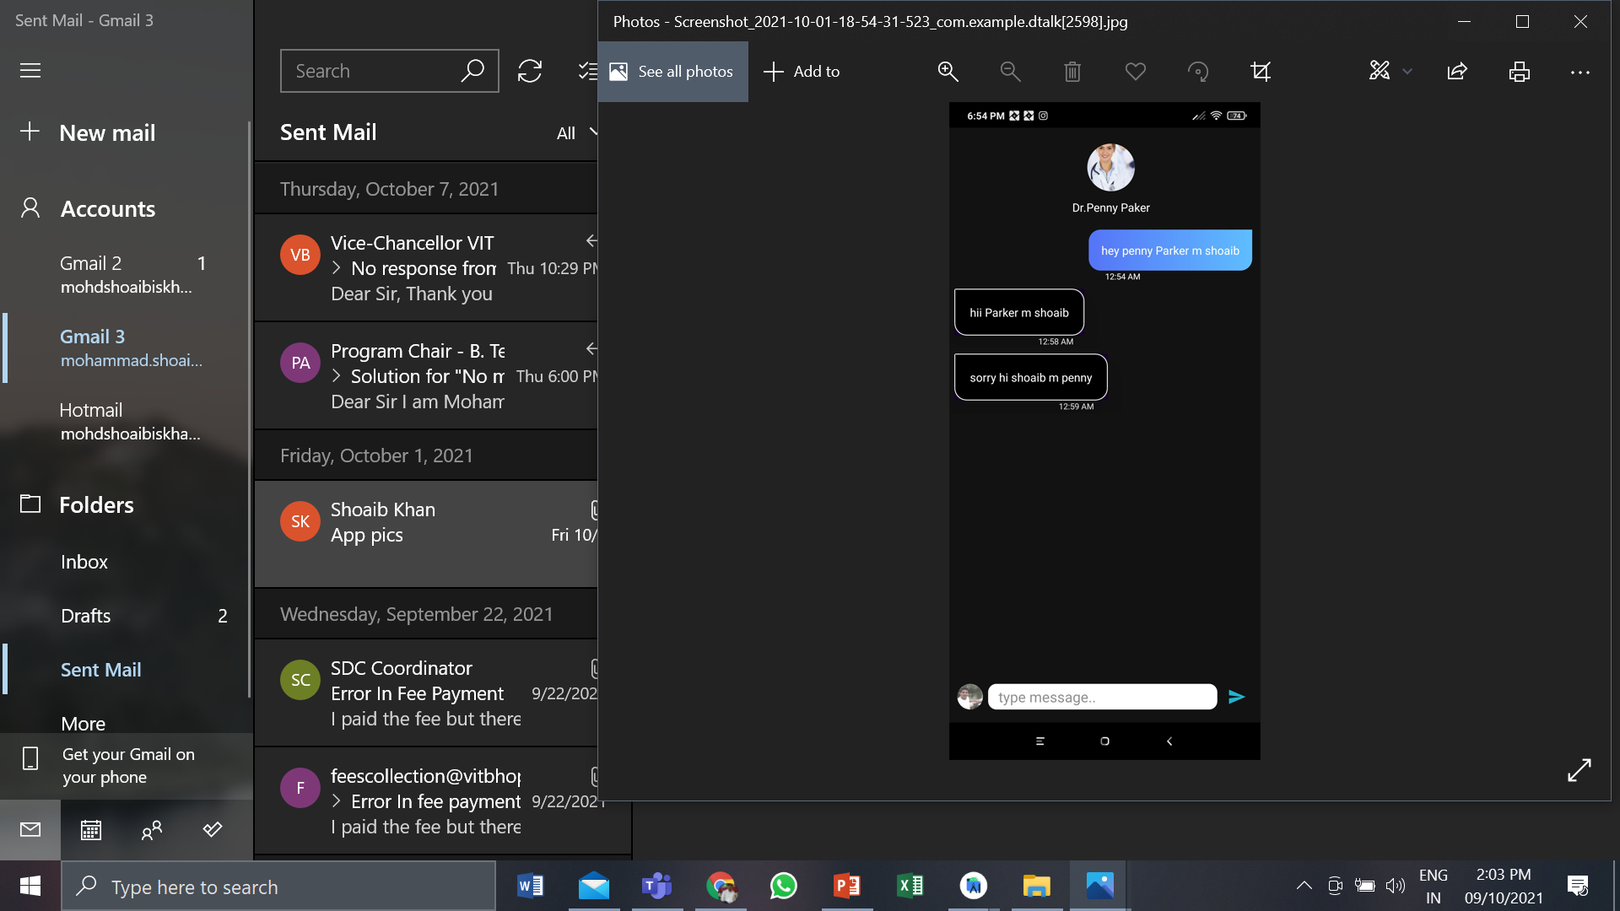

Slide 4
Limitations
Server Deployment.
Not For IOS platform.

Slide 5
Hardware and software requirements
For implementing machine learning model​
Anaconda
Python 3.0 and above
For creating the android application​
Android studios
Kotlin​ 2.0 and above
Firebase as the database.
Real time Usage
Basic Android Smartphone.
Internet connectivity

Slide 6
Proposed Work
- This is an android app which will inform users about the possible disease they may be suffering from and it will provide them with a list of precautions . ​
- Furthermore, it will provide a list of specialized doctors according to the disease and users can contact them in the chat feature where they can set an appointment as per convenience.

Slide 7
Methodology
Gather information about our idea and its feasibility.​
Perform Data Cleaning, setup the Machine Learning model.​
Design the UI of android application​.
Deploy the model into android application.​
Connectivity with the firebase database.​
​

Slide 8
Novelty Of The Project
As mentioned earlier DTalk uses artificial intelligence and other subfields .​
Extracting and analyzing that wealth of information in an accurate, timely, and reliable manner has been a continual challenge. DTalk helps to provide an accurate analytical response to queries which may concern patients.​
The project helps to provide reliable information to users easily with just a tap on their device. Disease prediction on the internet seems to be quite erratic, with inconsistent and often over exaggerated predictions of the disease.
​

Slide 9
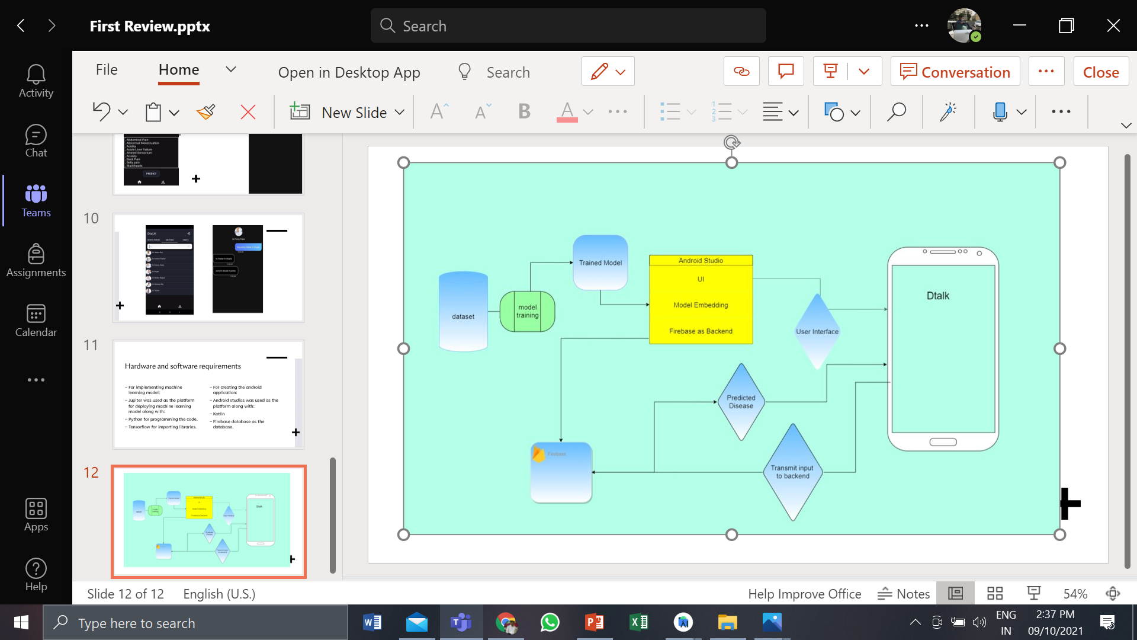
Overall System Architecture

Slide 10
Roadmap
STAGE 01
UI/UX Design
Creating ML Model
STAGE 03
Android Development
STAGE 02
STAGE 04
Database connection

Slide 11
Module description of dtalk
We have broadly classified our module into three categories:
Training the model.
Performance Analysis
User Interface UI/UX
Application.

Slide 12
1.Training the model
The dataset for our Machine Learning model was taken from Kaggle
We used Random Forest classifier as well as TensorFlow to predict the possible disease using symptoms.
After this data cleaning was done using NumPy, pandas and matplotlib.
Training of model was done using two algorithms one using TensorFlow and other one using Random Forest Classifier.
At last we exported .tflite file in which we have stored all the required constraint in a binary form.

Slide 13
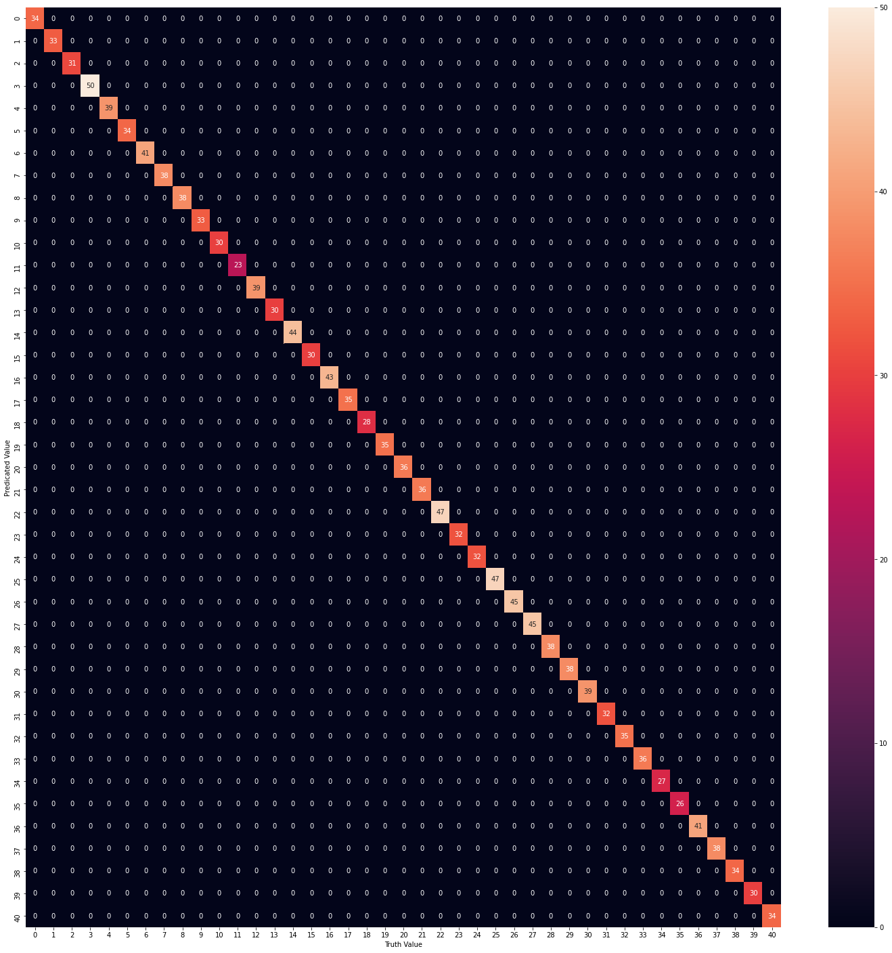
2. Performance analysis
We trained our model on 80% of the available data and performed testing on the rest 20% of data.
The results of this testing were obtained were above 0.95 accuracy i.e 95%.
We then plotted the expected value vs truth value heatmap.

Slide 14
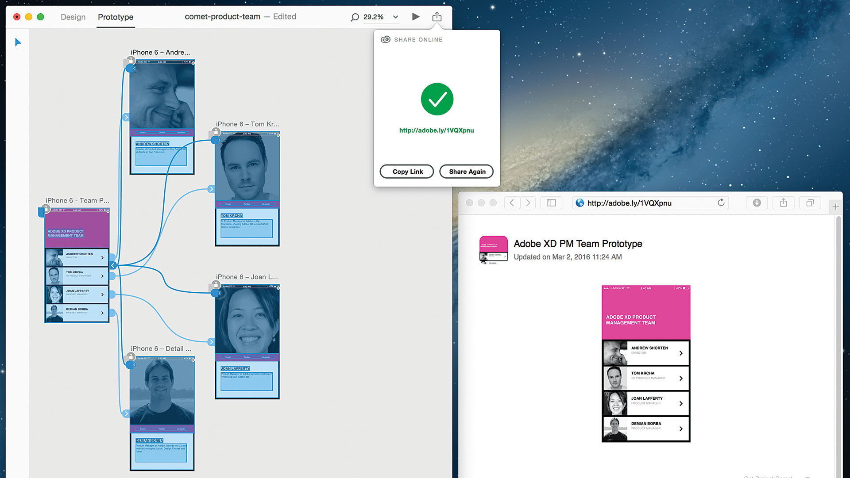
3. User Interface
User Interface was created Using Adobe XD.
All just user needs to do is select symptoms of their disease.
Easy to use interface.
Can be used in all the smartphones using Android 9 and above.
Fig : Adobe XD Interface

Slide 15
4. Application
Logics of the application was written in Kotlin.
Application possess all the list of diseases, doctors and precautions.
It also has a chat feature where you can reach all the available doctors.
Firebase is used as a backend where all the information related to a profile will be stored.

Slide 16
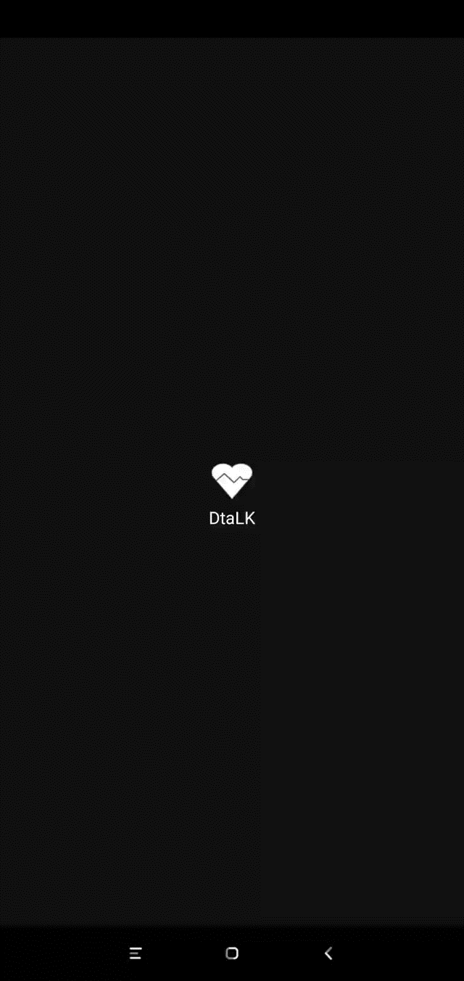
Demo video
Dtalk

Slide 17
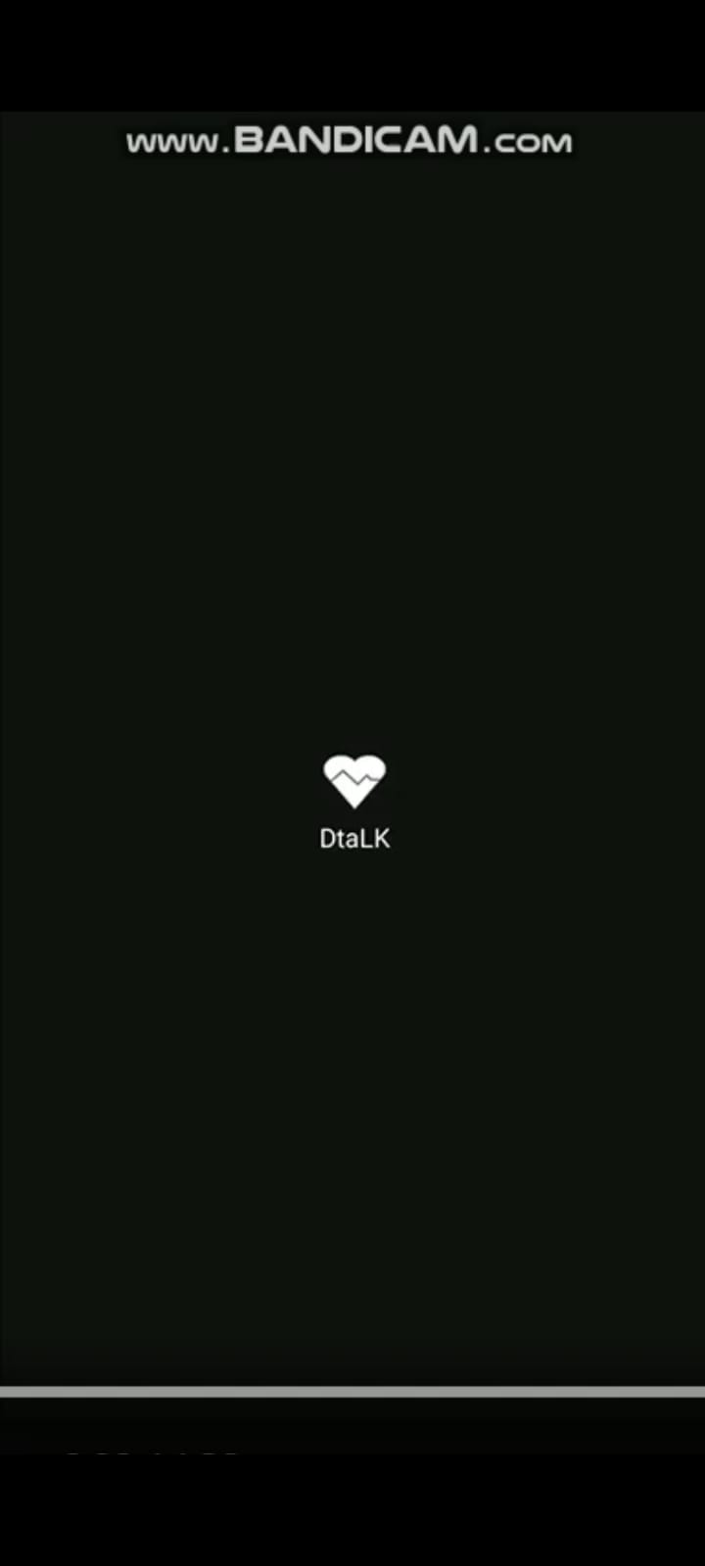
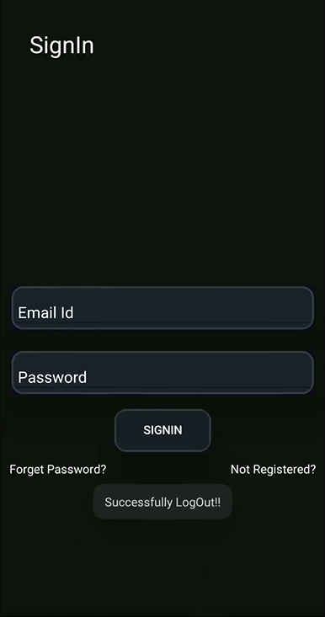
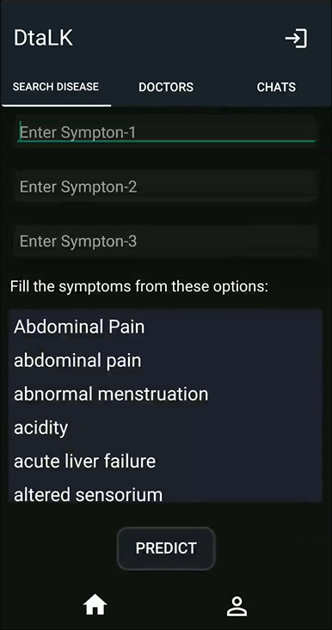
Snapshots

Slide 18
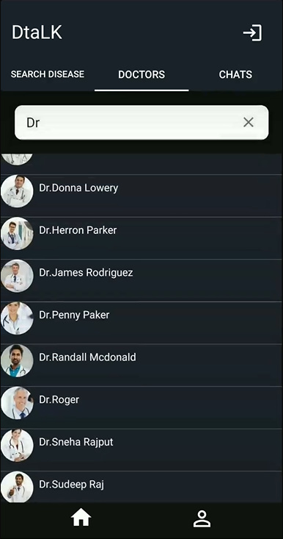
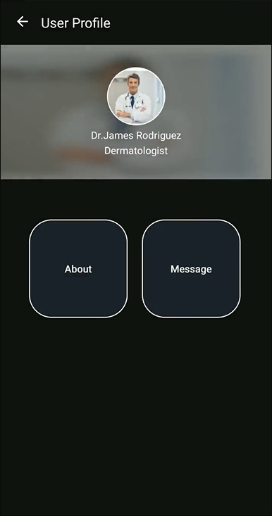
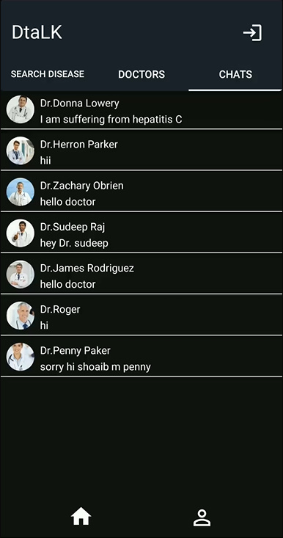

Slide 19
Results
It facilitates the service of health just one touch away.
Make people more concerned about their health.
Utilizes the previous data of a person’s medical history.
Allows the professionals of the medical field to work from any part of the world where internet exist.
Can be a source of active income.

Slide 20
Thank You

